Slide 1

Impact of Local Organizations on Disaster Relief
Hafsa Khan

Slide 2

Concept
T
1
🠺
🠺
Figure out if NonProfits reduce the number of days a disaster lasts
Predict the number of days a disaster lasts
Did you know:
NonProfit Sector grew faster in terms of employment and wages than the Government or Business sector in the U.S from 2000 - 2010 - NonProfitPro

Slide 3
Table of Contents
01
02
03
04
T
🠺
Data Collection
How was the data collected from various resources
🠺
Data Analysis
What analysis I performed on the data
Prediction
What I used to predict how long a disaster lasts
Further Developments
What would I like to explore further

Slide 4
01
Data Collection
T
1
🠺
🠺

Slide 5
01
03
05
02
04
T
🠺
🠺
Online dataset - Federally declared disasters by FEMA
Web scraping
State population and Total Area data
Clean data for analysis and prediction
Charity Navigator APIs
Restructure datasets combine information from all sources

Slide 6
02
Data Analysis
T
2
🠺
🠺

Slide 7
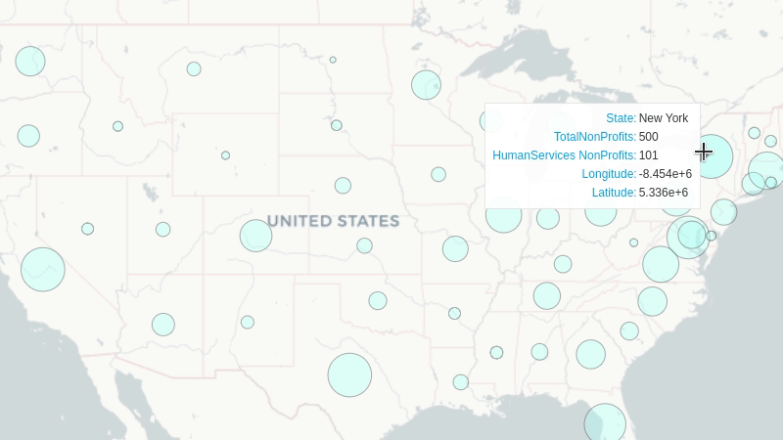
NonProfits across United States
T
1
🠺
🠺
YOUR TAGLINE HERE

Slide 8
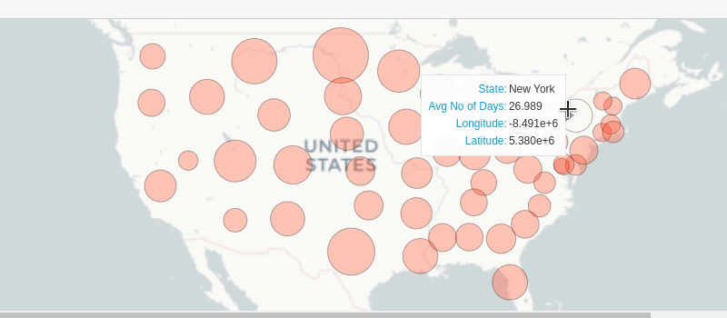
Avg No. of Days a Disaster Lasts
T
1
🠺
🠺
YOUR TAGLINE HERE

Slide 9
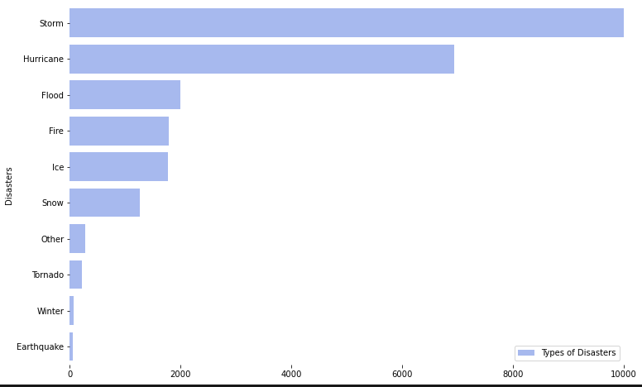
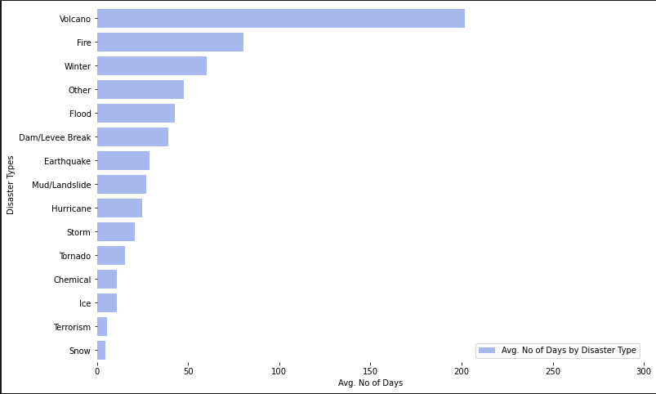
Data Analysis
Occurrence of disaster types
Avg no of days a disaster lasts
T
2
🠺
🠺
YOUR TAGLINE HERE
YOUR TAGLINE HERE
YOUR TAGLINE HERE
YOUR TAGLINE HERE

Slide 10
03
Prediction
T
3
🠺
🠺
Machine Learning Algorithm

Slide 11
Features
Feature
Target Variable
Feature
Features (Nonprofits)
T
🠺
🠺
If the State signed up for different Federally Administered Programs
No of days a disaster lasted
Different Disaster Types
State Population
Total Area
Count of different types of Nonprofits
Total No of Nonprofits in the State

Slide 12
Prediction Results
Linear Regression
RandomForestRegressor
RandomForestRegressor
T
2
🠺
🠺
r2 = 0.231
MAE = 19.69
With NonProfit Data
r2 = 0.771
MAE = 8.72
Without NonProfit Data
r2 = 0.777
MAE = 8.72

Slide 13
04
Further Developments
T
4
🠺
🠺

Slide 14
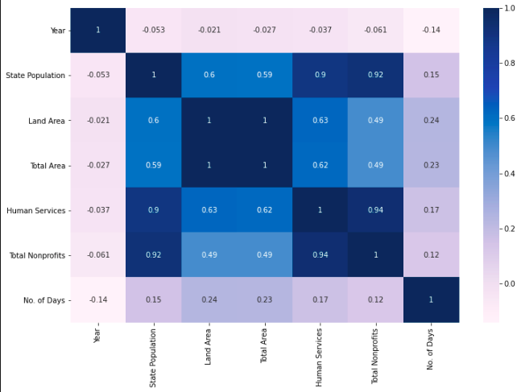
Further Developments
Next steps...
T
1
🠺
🠺
State Population and Total NonProfits are highly correlated
Data with other countries might show a stronger correlation between: No. of NonProfits and Disaster Relief
Different Target Variable
e.g. No. of affected
Maybe try a Neural Network like TabNet

Slide 15
Thank-you
T
5
🠺
🠺

